Slide 1
Project Review
Danny Varela | Andrew Park | Mario Perez
F15C6

Slide 2
Conceptual, Relational, &
Logical Models
1
F15C6

Slide 3
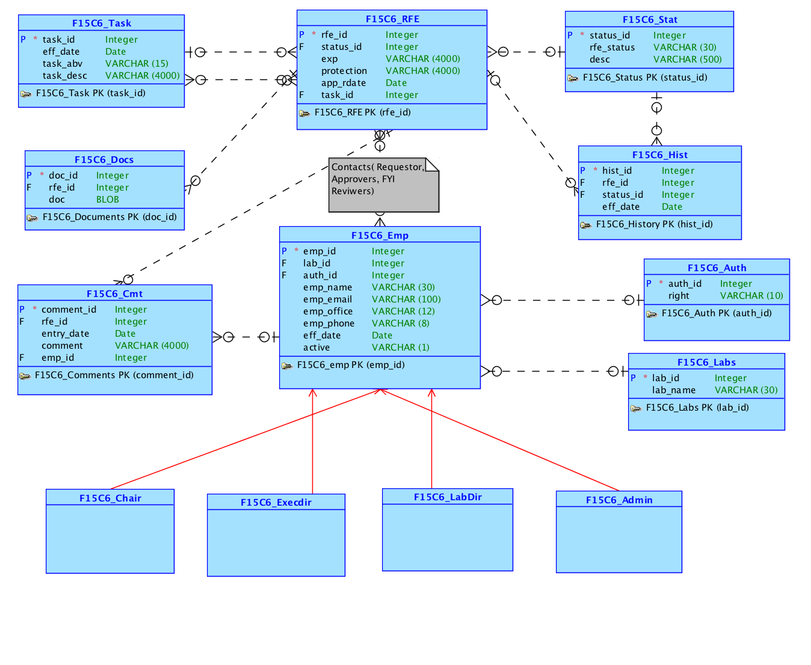
Conceptual Model
Changes:
No seperate relations for FYI Reviewers, Approvers, Requestors
One-To-Many Relationship on Auth Table.
F15C6

Slide 4
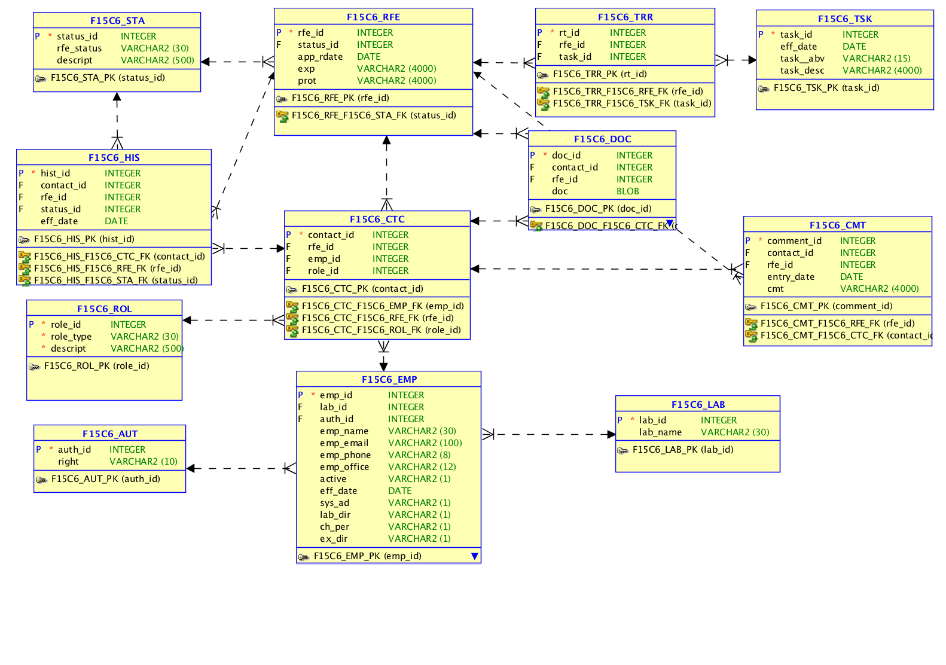
Relational Model
F15C6

Slide 5
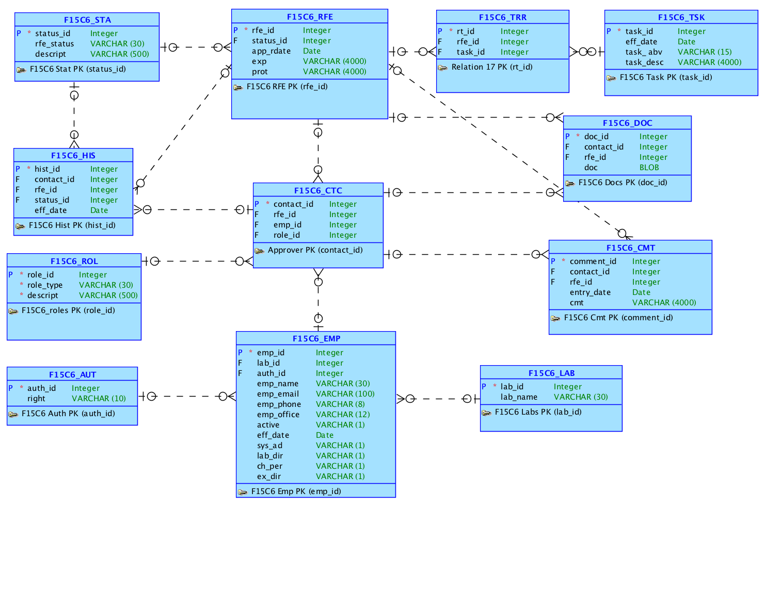
Logical Model
Notice:
CTC Table
Association Table between RFE and TSK
Flags in EMP
F15C6

Slide 6
APEX Application
2
F15C6

Slide 7
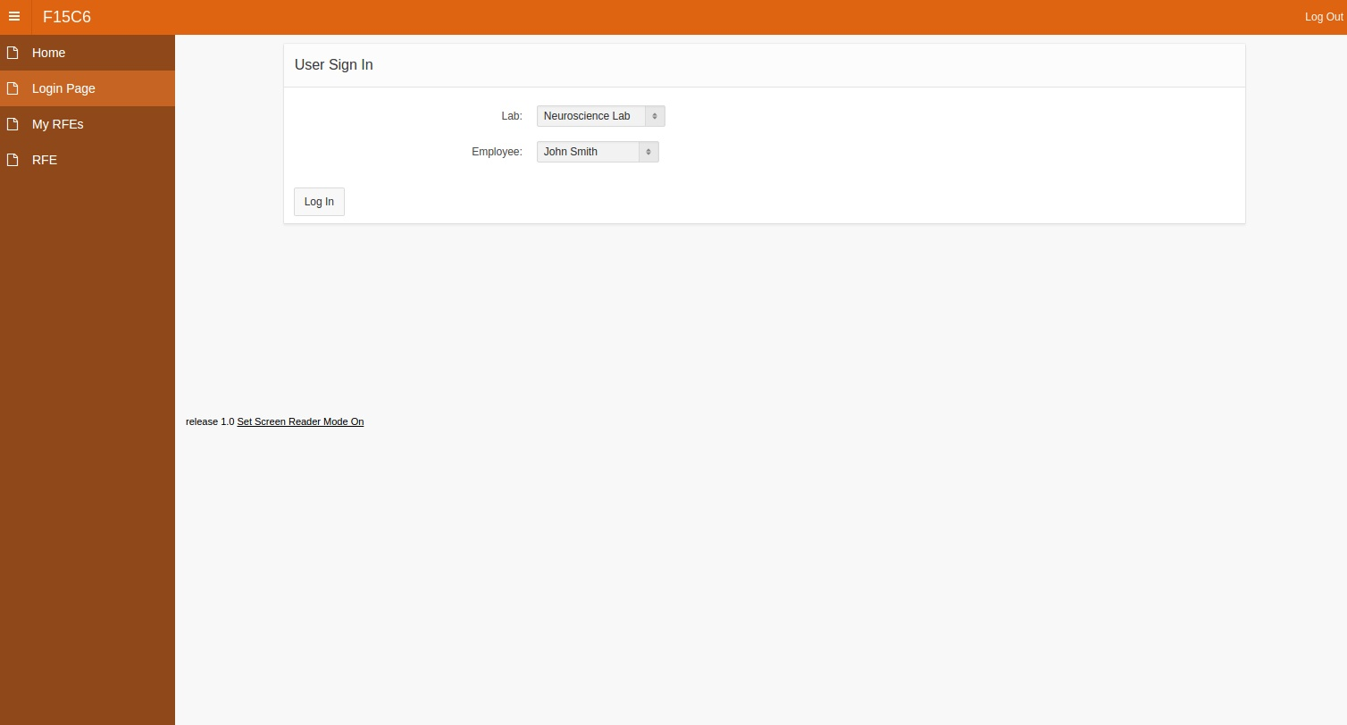
https://apex.oracle.com/pls/apex/f?p=12516:1:103990535041997:::::
F15C6

Slide 8
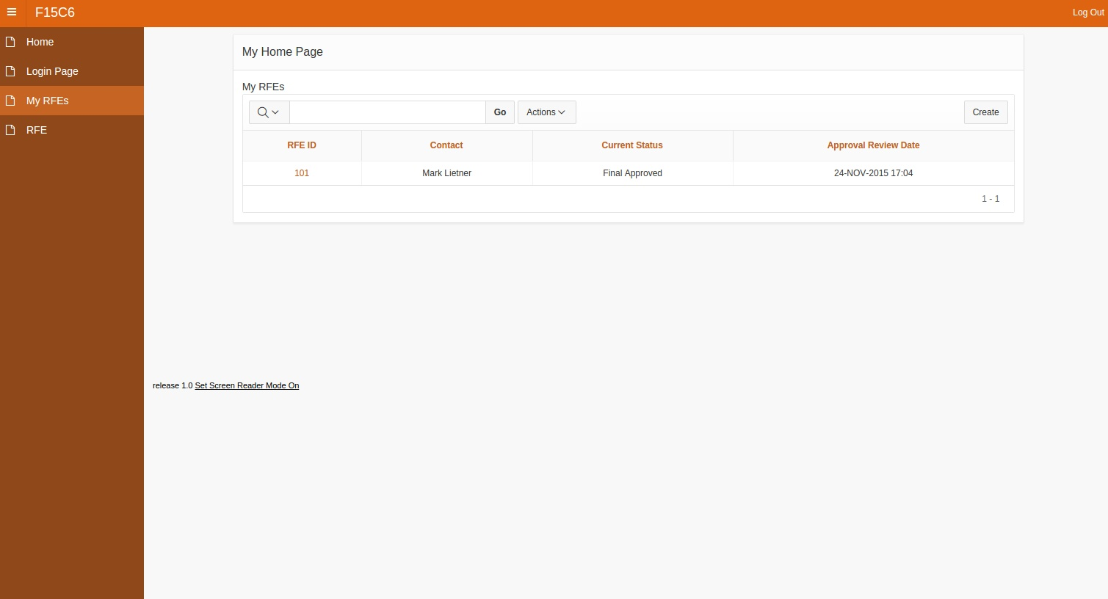
https://apex.oracle.com/pls/apex/f?p=12516:1:103990535041997:::::
F15C6

Slide 9
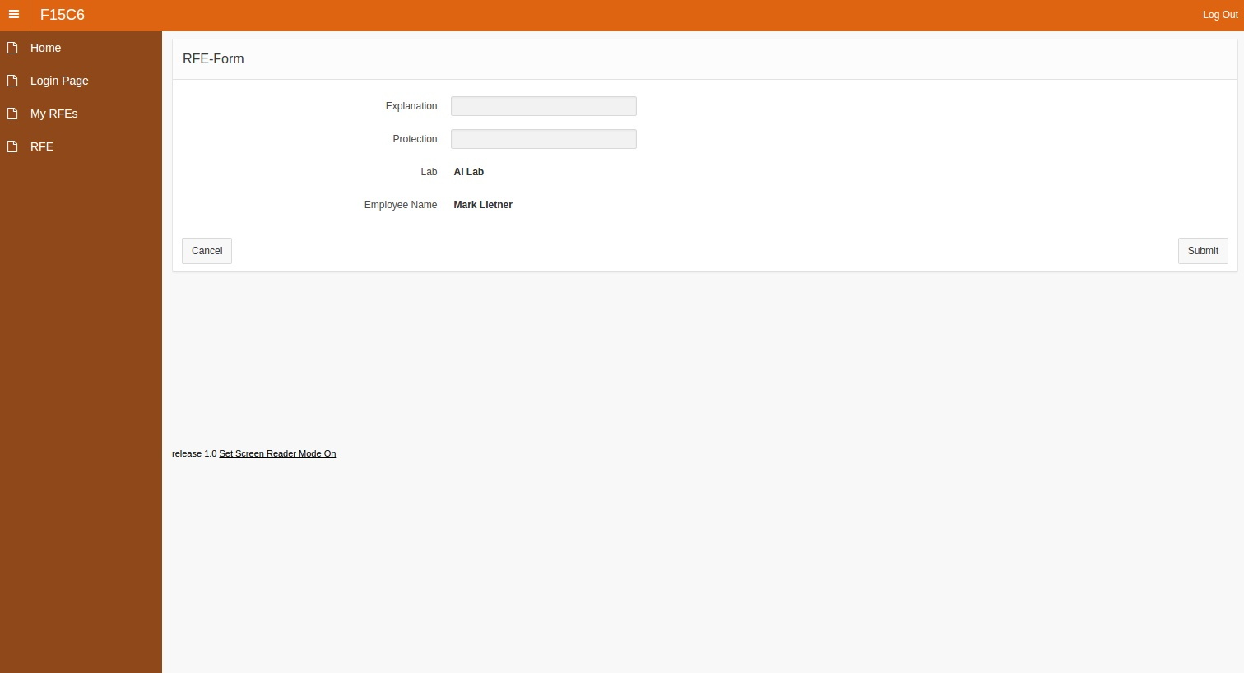
https://apex.oracle.com/pls/apex/f?p=12516:1:103990535041997:::::
F15C6

Slide 10
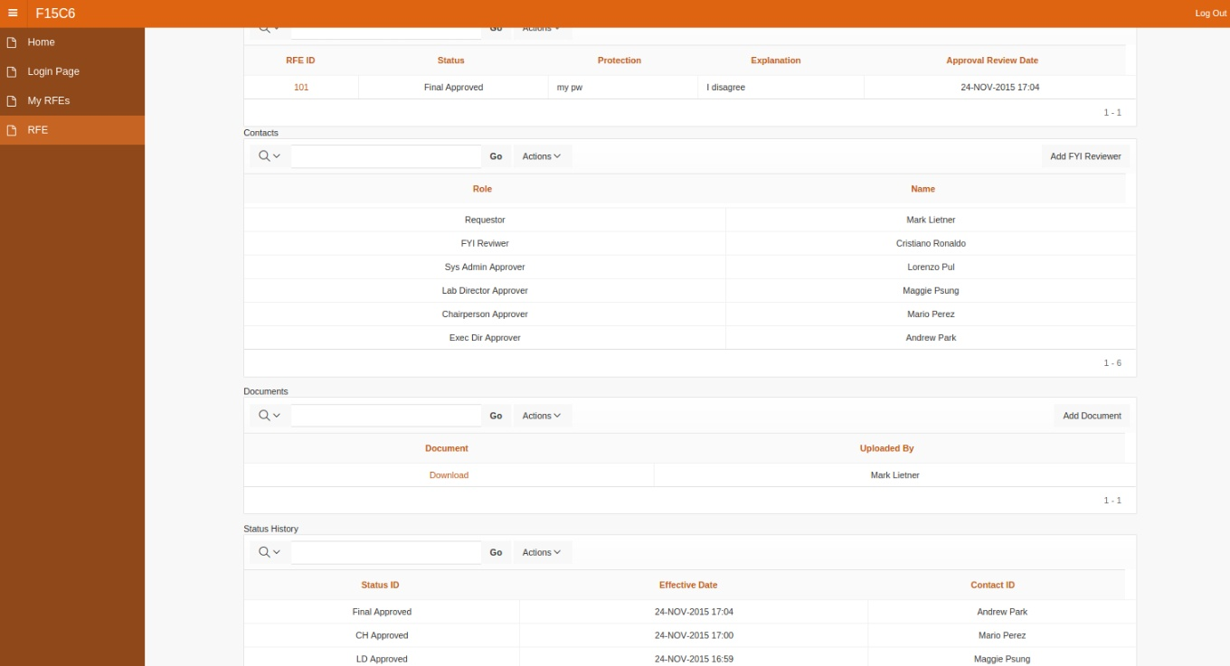
https://apex.oracle.com/pls/apex/f?p=12516:1:103990535041997:::::
F15C6

Slide 11
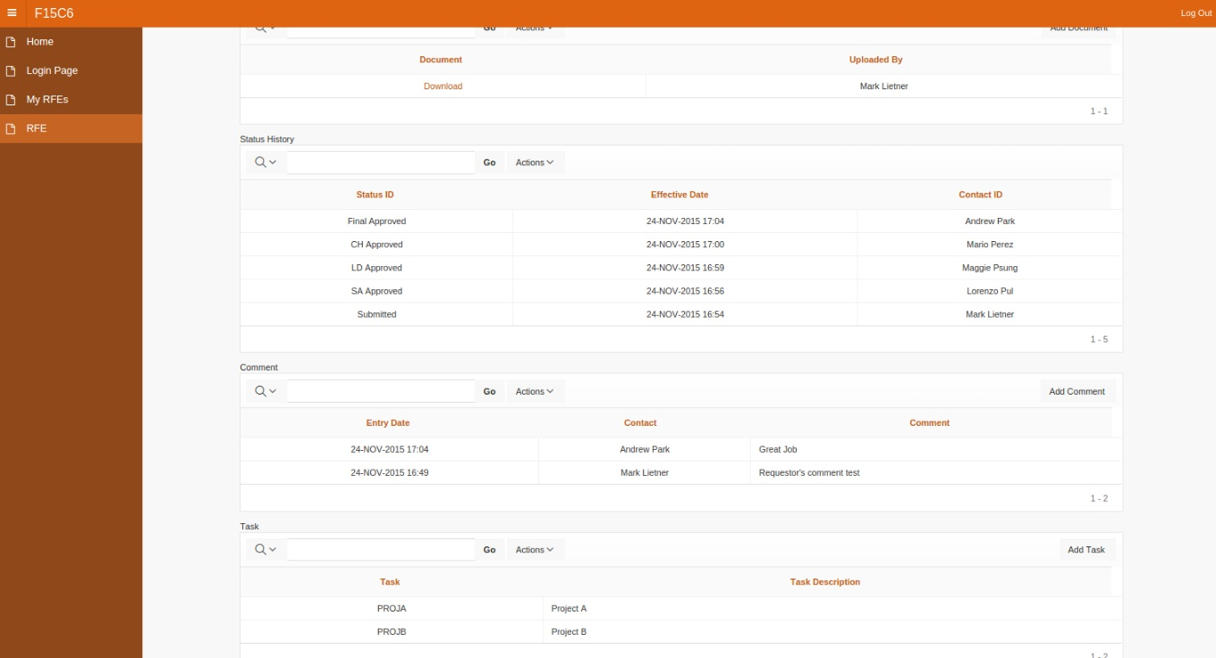
https://apex.oracle.com/pls/apex/f?p=12516:1:103990535041997:::::
F15C6

Slide 12
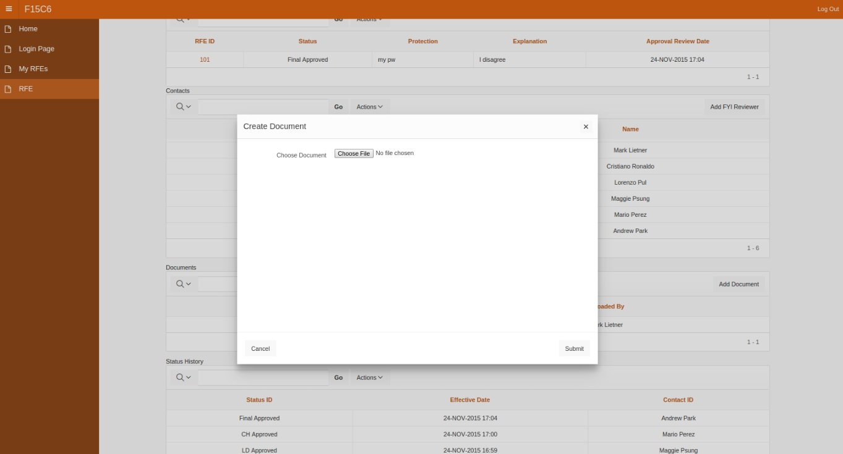
https://apex.oracle.com/pls/apex/f?p=12516:1:103990535041997:::::
F15C6

Slide 13
Part II
Conceptual
Model
3
F15C6

Slide 14
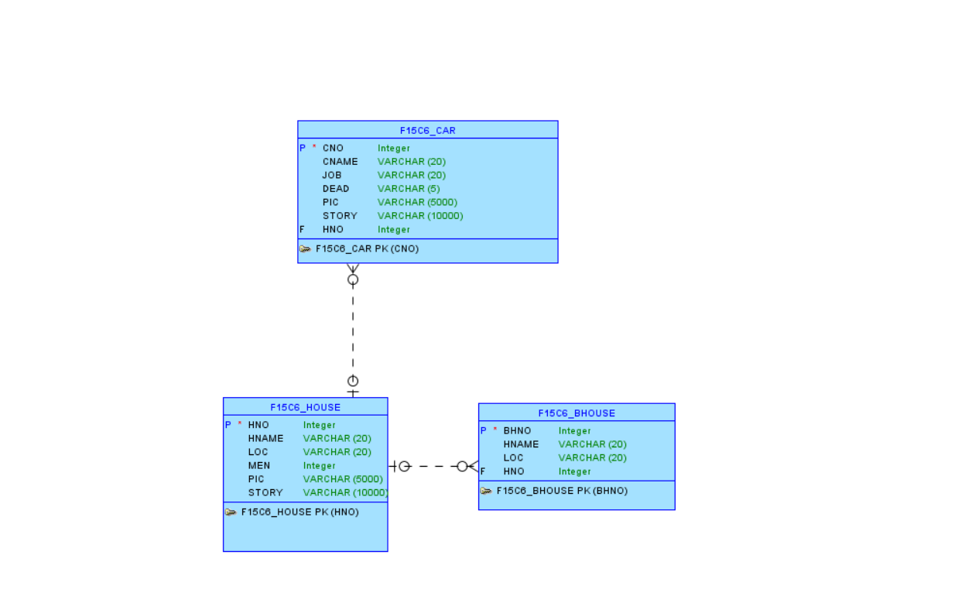
Conceptual Model
Simplified model of relationship between characters and houses of Game of Thrones
F15C6

Slide 15
Part II
Application
4
F15C6

Slide 16
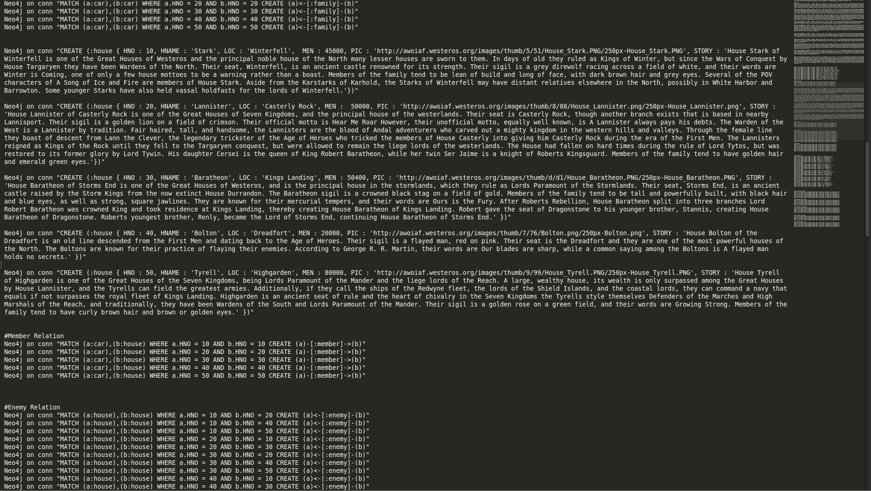
NEO4J Cypher
F15C6

Slide 17
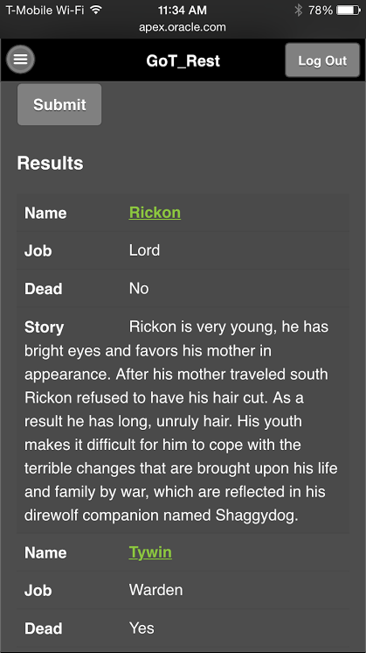
Android Application
Features:
List of prominent characters
Includes short background
Name acts as a link
https://apex.oracle.com/pls/apex/f?p=54393:1:103990535041997:::::
F15C6

Slide 18
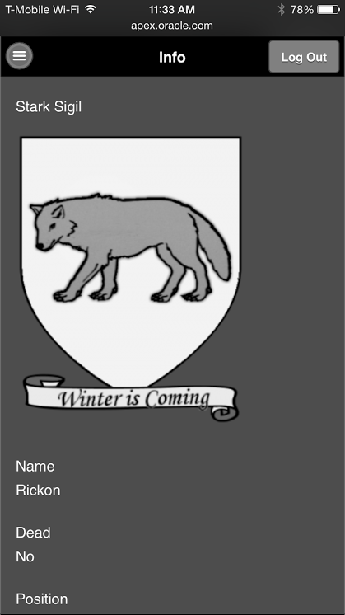
Android Application
Features:
Sigil
Name
Dead
Position
House Lore
https://apex.oracle.com/pls/apex/f?p=54393:1:103990535041997:::::
F15C6

Slide 19
F15C6 Github Repo
https://github.com/DannyV2/F15C6.git
F15C6

Slide 20
Thank You!
F15C6

